Slide 1


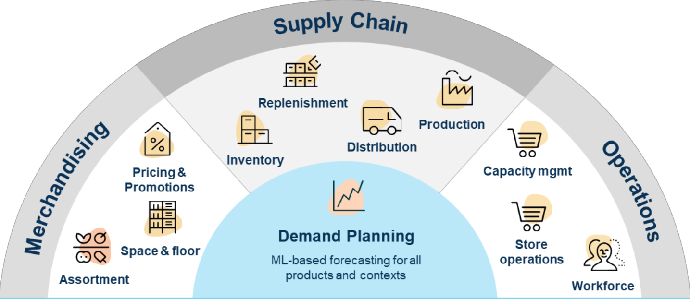
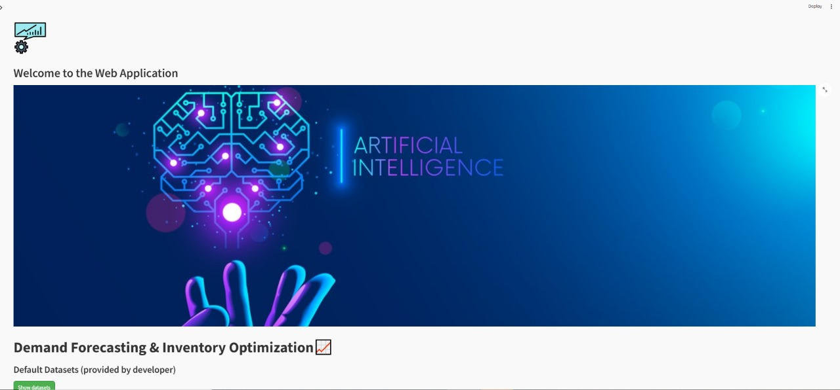
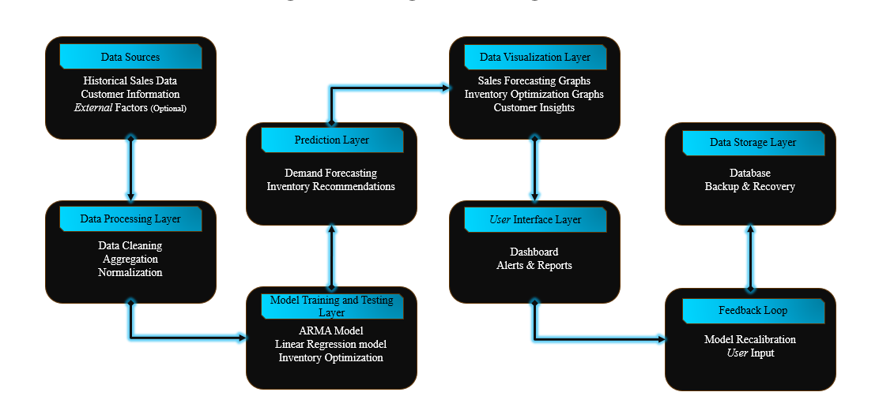
INVENTORY MANAGEMENT AND DEMAND FORECASTING USING MACHINE LEARNING
Department of Artificial Intelligence & Data Science
School of Computing
ABSTRACT
Describe The Solution
RESULTS
Explain the Technology Stack
Effective inventory management is essential for businesses to meet customer demands while minimizing costs. Accurate demand forecasting plays a critical role in preventing stockouts and overstock situations. This study explores the integration of machine learning and extensive historical data to enhance inventory demand forecasting systems. The primary objective is to optimize inventory levels through precise demand predictions, identify purchasing trends to align production schedules, and improve resource allocation for increased customer satisfaction and profitability.
Data preparation involved loading historical sales data into a pandas Data Frame, followed by preprocessing to handle missing values, modify data types, manage categorical variables, and split the dataset into training and testing sets. Two machine learning models were employed: Time Series Forecasting using ARIMA, which predicts future demand based on historical trends, and Supervised Learning using Random Forest Regression, which leverages historical data for demand prediction.
Results demonstrate that both ARIMA and Random Forest Regression models effectively forecast inventory demand, enabling businesses to optimize stock levels, reduce costs, and enhance operational efficiency.
AI BASED
PERSONALIZATION
Inventory Optimization:
Random Forest Classifier
ARIMA
Sales prediction:
Linear Regression
ARIMA
Random Forest
LSTM Model
WEB APPLICATION
streamlit
pandas
numpy
scikit-learn
tensorflow
keras
plotly
sqlite3
hashlib
Datetime
time
chardet
warnings
statsmodels
Our inventory optimization and demand forecasting solution leverages advanced data analytics to enhance inventory management. By analyzing historical sales data, seasonal patterns, and relevant variables, we can forecast future demand with high accuracy. This proactive approach helps maintain optimal stock levels to meet customer needs without overstocking, reducing both costs and waste.
Using machine learning models like ARIMA and Random Forest Regression, our solution predicts inventory needs effectively, minimizing stockouts and excess inventory. Data preprocessing, feature extraction, and selection techniques prepare the data by ensuring it's clean and structured, ultimately boosting the model's performance and reliability in real-world scenarios.
Real-time monitoring and periodic updates ensure forecasts adapt to changing market trends, aligning inventory with customer demand shifts. This data-driven solution empowers businesses to make informed decisions, enhancing operational efficiency and customer satisfaction by ensuring products are consistently available when needed.
Our inventory optimization and demand forecasting project effectively minimizes stock imbalances by predicting demand trends accurately. This leads to optimized inventory levels, reducing both excess stock and the risk of stockouts, which directly improves operational efficiency and lowers holding costs.
Through precise demand forecasting, our solution enables businesses to make data-driven decisions that meet customer needs promptly. The model's accuracy in forecasting helps align inventory availability with real-time demand, contributing to smoother supply chain operations and enhanced customer satisfaction.
Overall, our solution supports better planning and efficient resource allocation. The project’s results help prevent costly inventory mismanagement, improve service levels, and promote sustainable practices by reducing waste. This proactive inventory management ultimately strengthens the business's competitiveness and customer retention in a dynamic market.
TECH STACK
Figure 1.
Figure 2.
Explain the work flow of the solution
Describe the USE CASES
TEAM MEMBER DETAILS
Describe the DEPENDENCIES and SHOW STOPPERS
Retail Inventory Optimization:
Accurate demand forecasting enables retailers to stock the right products in the right quantities, optimizing inventory and enhancing customer satisfaction.
Product Sales Prediction & Forecast:
Demand forecasting models allow manufacturers to produce according to anticipated demand, rather than on assumption-based production schedules.
Dependencies:
Data Availability
Model Selection
Software & Tools
Processing Power
Data Quality
Skillset of Team
Show Stoppers:
Data Inconsistency
Model Overfitting
Limited Hardware
Unanticipated Costs
Low Model Accuracy
Stakeholder Alignment
1 SETHU RAMAN Y (VTU 21546)(22UEAD0067)
2.INIYAVAN S (VTU 22510)(22UEAD0013)
3.NAVADEEP J (VTU 23403)(22UEAD0040
ACKNOWLEDGEMENT
Dr. V. Dhilip Kumar/ Professor
TTS 2750
PHONE NO : 9994614463
Email-ID : vdhilipkumar@veltech.edu.in

